Slide 1
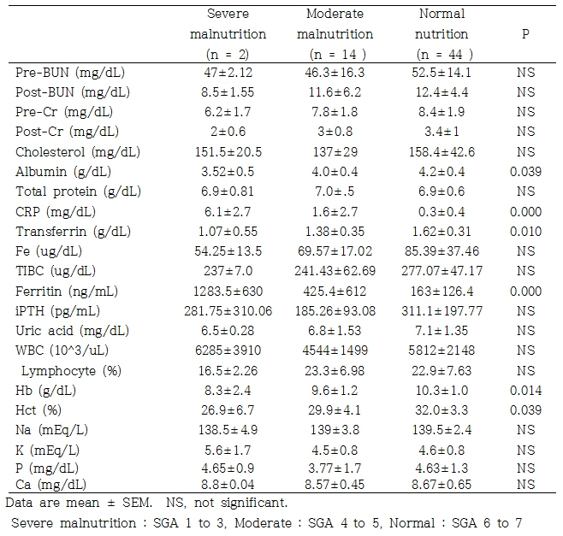
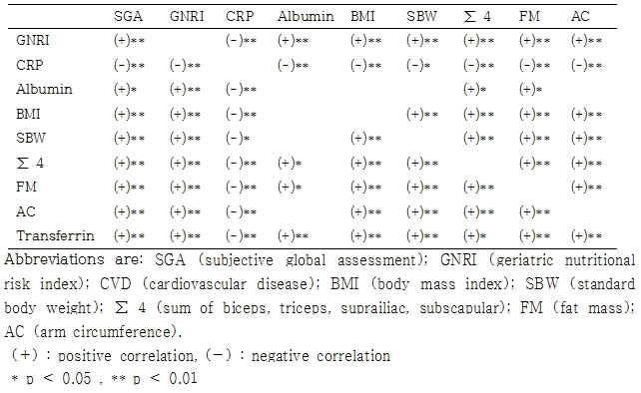
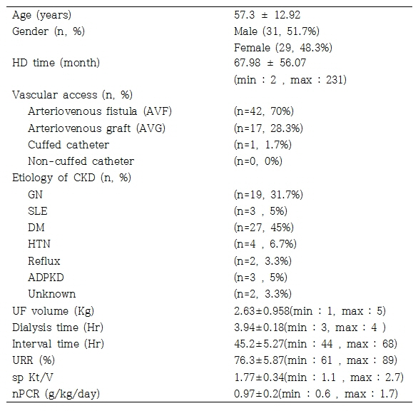
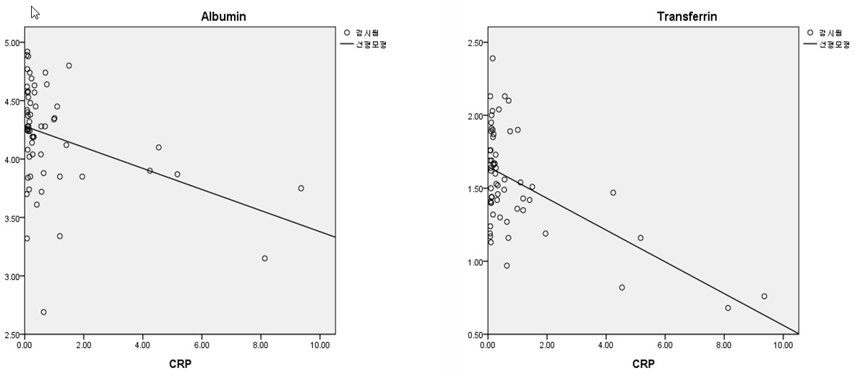
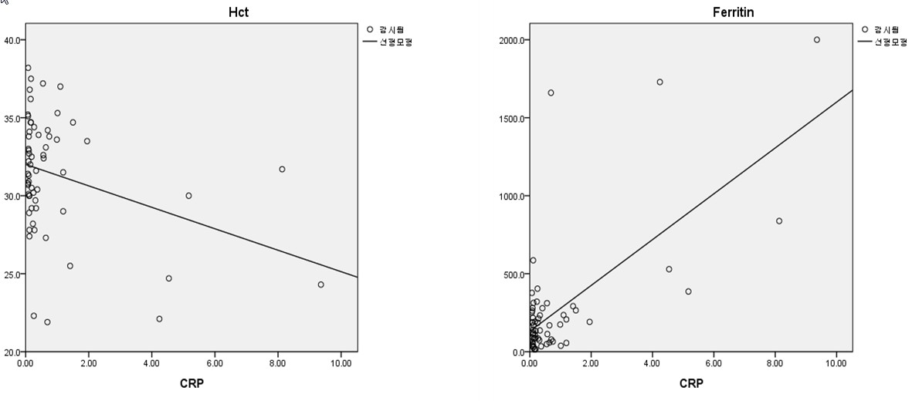
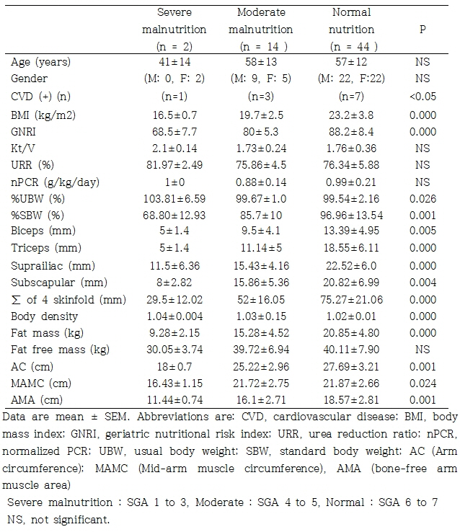
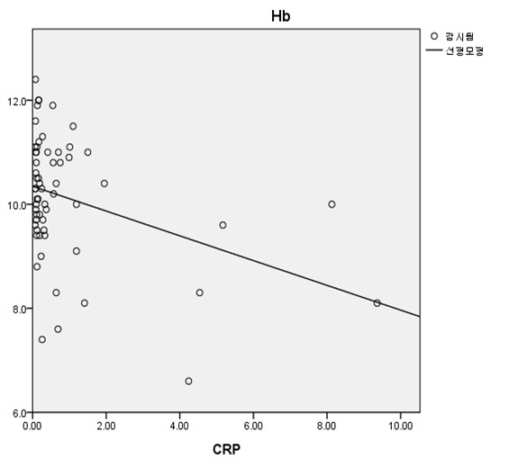
Biomarkers to Appraise Protein-energy wasting (PEW) and Association of Inflammation and PEW in Maintenance Hemodialysis Wan Soo Lee, M.D., Jong Hoon Chung, M.D., Hyun Lee Kim, M.D.,Byung Chul Shin, M.D. Division of Nephrology, Department of Internal Medicine, Chosun University Hospital
Purpose
Protein-energy wasting (PEW) contribute significantly to the increased cardiovascular mortality among dialysis patients. However, there is no isolated marker capable of assessing the nutritional status of patients with chronic kidney disease.
We investigated several parameters to appraise PEW and association of inflammation and PEW in maintenance hemodialysis patients.
Comparisons of laboratory parameters in 60 ESRD patients in MHD with SGA
METHODS:
Sixty patients were enrolled in this cross-sectional study. The nutritional status of the patients were divided three groups according to Subjective global assessment. 1) Severe malnutrition (SGA 1 to 3) 2) Mild to moderate malnutrition (SGA 4 to 5) 3) Well nutrition (SGA 6 to 7).
We also simultaneously checked inflammatory markers, nutritional markers, and performed an anthropometric measurements. The presence of interaction between the inflammation , cardiovascular disease and PEW was examined.
Data show Pearson's correlation coefficient
RESULTS:
Characteristics of patients undergoing maintenance HD
Figure. Association between C-reactive protein and other parameter
Comparisons of anthropometric parameters in 60 ESRD patients in MHD with SGA
CONCULUSION:
SGA is a simple and inexpensive method in clinical practice, detected the patients with PEW.
Serum C-reactive protein is a strong predictor of malnutrition and inflammation in hemodialysis population.
The sensitivity can be increased by associating serum albumin with other nutritional and anthropometry markers to correctly evaluate the nutritional status of hemodialysis patients.

