Slide 1
Agreement between Central Venous and Arterial Blood Gas Measurements in the Intensive Care Unit
Original Articles
Richard Treger, Shahriar Pirouz, Nader Kamangar, and Dalila Corry
Clinical Journal of the American Society of Nephrology, March, 2010
2009년 4월 6일 R4 이완수
Notes:
Agreement 일치

Slide 2
ABGA (arterial blood gas analysis)
Determine the “acid-base and respiratory status” of critical patient
But, “patient discomfort”
Arterial injury
Thrombosis or embolization
Hematoma
Aneurysm formation
Reflex sympathetic dystrophy
Needle stick injury
Notes:
Reflex sympathetic dystrophy -

Slide 3
Vein sampling?
Relatively safer procedure
VBGA (venous blood gas analysis)
May be an alternative to ABG analysis for acid-base status ??
Accuracy of VBG values?
A few studies have expressed reservation
Notes:
reservation (단서)

Slide 4
Previous study ?
Dose not examined
the agreement in arterial and central venous BG samples
among all of the commonly used parameters
(pH, PCO2, bicarbonate)
in a diverse population of medical ICU patients.
No multiple paried ABG and VBG sample
from each patient

Slide 5
Main objective
examine the agreement between ABG and central VBG samples
for all commonly used parameters
(pH, PCO2, bicarbonate)
in a pathologically diverse ICU patient population
multiple paired arterial and venous samples from each patient.
Secondary objective
compare central and peripheral VBG values (pH, PcO2, bicarbonate)

Slide 6
Materials and Methods
Single-center, Prospective trial
Conducted in the medical ICU at Olive View-UCLA Medical Center
All adult patients, admitted to ICU
When, ABG was deemed to be necessary
→ central venous sample was also obtained within 2 min.
A maximum of 10 paired ABG-VBG samples were obtained per patient
d/t prevent a single patient from dominating the data set.

Slide 7
Materials and Methods
Additional data
primary diagnosis
intubation status
use of isotropic agents
Hypotension (systolic BP <90 mmHg)
Data comparing central and peripheral VBG values were also obtained. (within 2 min)

Slide 8
Statistical Analysis
The Bland-Altman method was used
to assess agreement between Arterial (A) and central venous (V) measurements
(pH, PCO2, and bicarnonate)
★ Bland-Altman plots?
새로운 측정(또는 진단) 방법이 개발되었을 때
새로운 방법의 측정값이 기존의 방법의 측정값과 비교해서 문제가 될 정도의 차이가 없음을 밝힐때 쓰는 통계학적 graphical techinique
X축 - 두방법의 평균값 (mean)
Y축 - 두방법으로 측정한 값의 차이
Cf) Mean±2SD 를 limits of agreement라 한다
“The average value ( [A+V] / 2 )”
“The A-V different”
Notes:
Plotted - > 계획되다
SD : 표준편차(Standard Deviation)
95% prediction intervals 예측구간
95% prediction intervals (limits of agreement)

Slide 9
Statistical Analysis
“Linear regression” (회계분석)
was used to establish equations
for estimation of arterial values from central venous values.
★ Regression (회귀분석)
회귀분석이란 종속변수(Y)의 변화를 독립변수(X)들의 선형 조합으로
설명하려는 분석기법
Y=a+bx+c
독립변수가 1개 → 단일회귀분석 (simple regression)
독립변수가 여러개 → 다중회귀분석 (multiple regression)
X → venous value
Y → arterial value
Notes:
The A-V different” versus “The average value ( [A+V] / 2 )” was plotted.
Slope(기울기), intercept(y절편)form
계산차이
Means, SDs, and 95% prediction intervals (limits of agreement) of the A-V differences are reported as well as the Pearson correlation between A-V and (A + V) / 2.
If there is no trend in the A-V differences, then this correlation should be 0
In addition
Pearson correlations between the arterial and central venous vaules are reported

Slide 10
multiple A and V measurements for a single patient
→ components of variance(분산) computations were carried out
→ a random slope and intercept model was used
d/t between-patient heterogeneity

Slide 11
Results
The study involved 40 patients with a total of 221 paired ABG-VBG samples.
31 paired samples were excluded
13 samples → clerical errors
16 samples → being run on different blood gas analyzers
2 samples → arterial and venous samples were drawn >2 minutes apart
190 paired samples were included in the analysis.

Slide 12
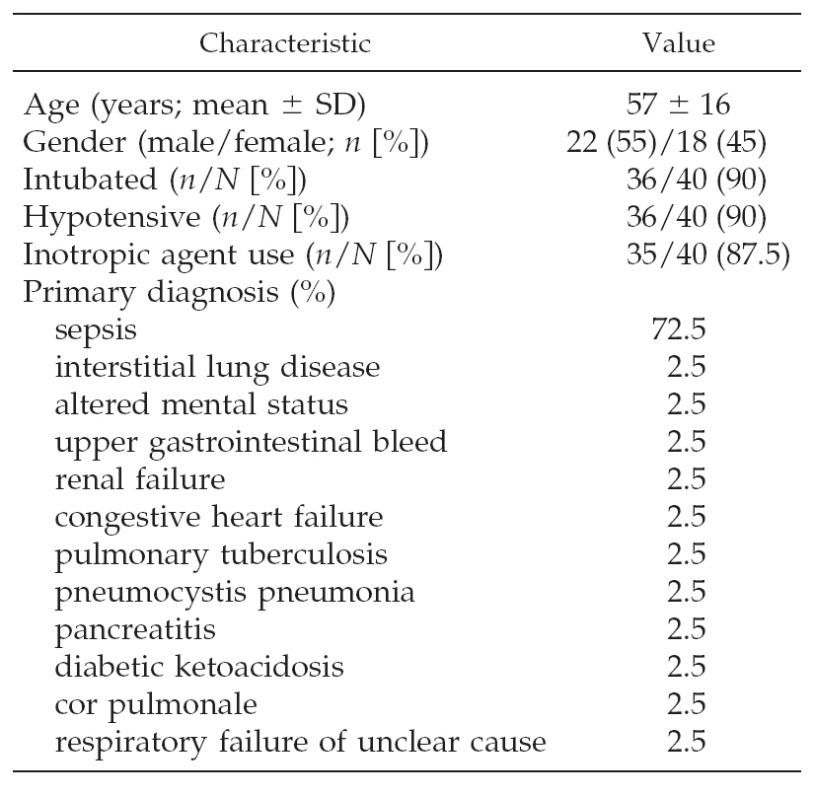
Table 1. patient characteristics
Notes:
Enroll된 환자군의 특성에 대해 살펴보면
평균나이 57세로 남자 55, 여자 45%로 비슷하였으며, medical ICU에서 치료한 환자군으로 90%가 intubation되어 있고 저혈압 소견을 보였으며, 87.5%에서 inotropics를 사용하였습니다.
ICU에 입원한 원인 질환으로는 sepsis가 72.5%로 가장 most common 하였으며, 다른 컨디션은 ICU 치료 받는 환자에서 주로 발생하는 condition으로 ILD, mentataion변화 GI bleeding, renal failure, CHF, TB, pancratiitis, DKA, cor pulmonale, respiratory failure 등을 보였습니다.
그리고 이 연구에 포함된 환자는 아무도 bicarnobate를 투여받지 않았습니다

Slide 13
No patients were receiving bicarbonate.
Arterial vs central venous intercept and slope homogenity tests for pH, PCO2, and bicarbonate
→ P values of 0.995, 0.122, and 0.497
Thus, all 190 obervations could be combined

Slide 14
arterial pH values (6.73 ~ 7.63)
Arterial PCO2 values (16 ~ 79mmHg)
Arterial bicarbonate values (2 ~ 45 mEq/L)
Table 2, mean values and SDs

Slide 15
★ Bland-Altman plots?
새로운 측정(또는 진단) 방법이 개발되었을 때
새로운 방법의 측정값이 기존의 방법의 측정값과 비교해서 문제가 될 정도의 차이가 없음을 밝힐때 쓰는 통계학적 graphical techinique
X축 - 두방법의 평균값 (mean)
Y축 - 두방법으로 측정한 값의 차이
Cf) Mean±2SD 를 limits of agreement라 한다
“The average value ( [A+V] / 2 )”
“The A-V different”

Slide 16
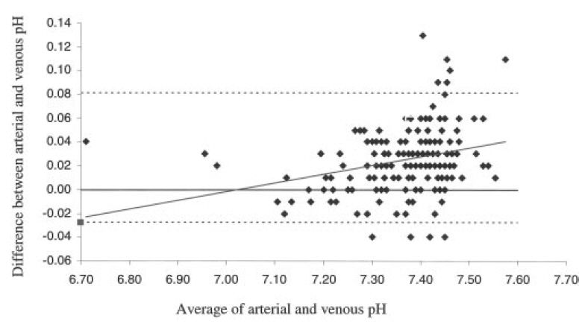
Figure 1
In regard to pH
mean A-V difference : 0.027 (SD 0.027)
95% limits of agreement of - 0.028 to 0.081

Slide 17
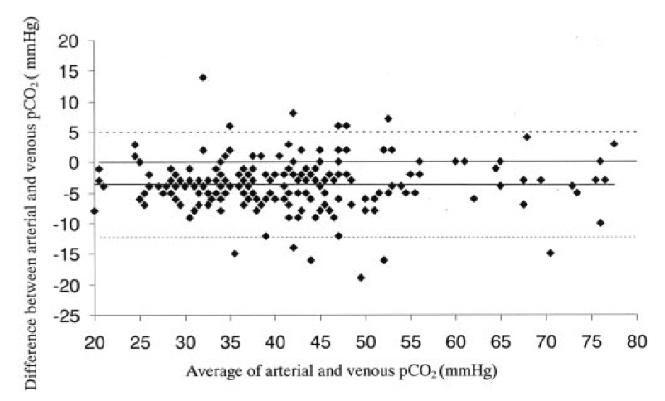
Figure 2
In regard to Pco2
mean A-V difference : 3.8 (SD 4.3)
95% limits of agreement of -12.3 to 4.8

Slide 18
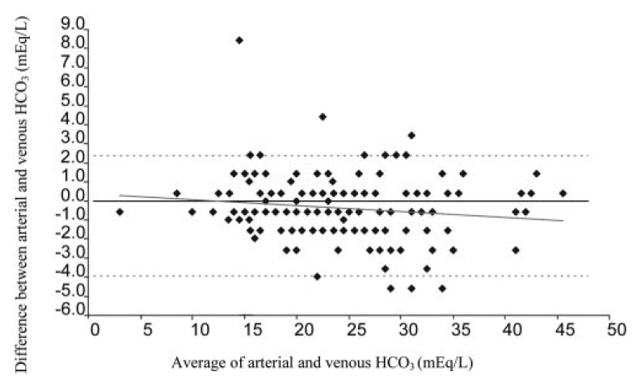
Figure 3
In regard to bicarbonate
mean A-V difference : 0.80 (SD 1.58)
with a 95% limits of agreement of 4.0 to 2.4

Slide 19
★ Correlation of venous and arterial blood gas value

Slide 20
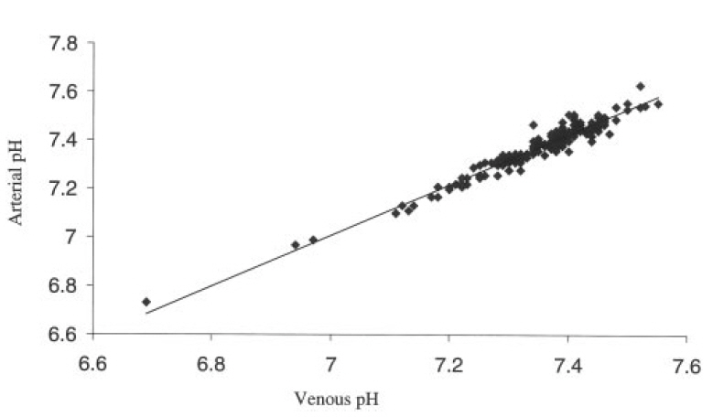
Figure 4
Venous vs arterial pH

Slide 21
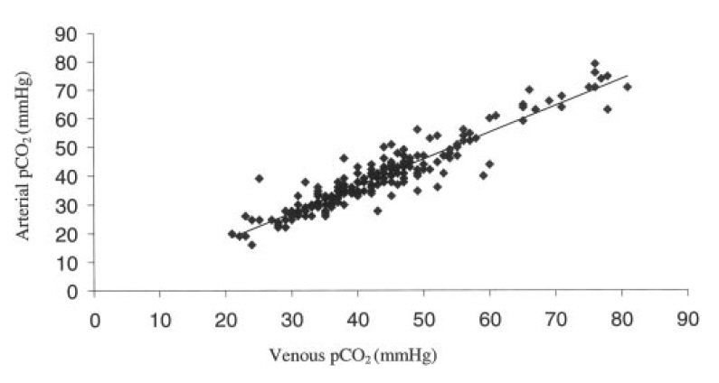
Figure 5
Venous vs arterial PCO2

Slide 22
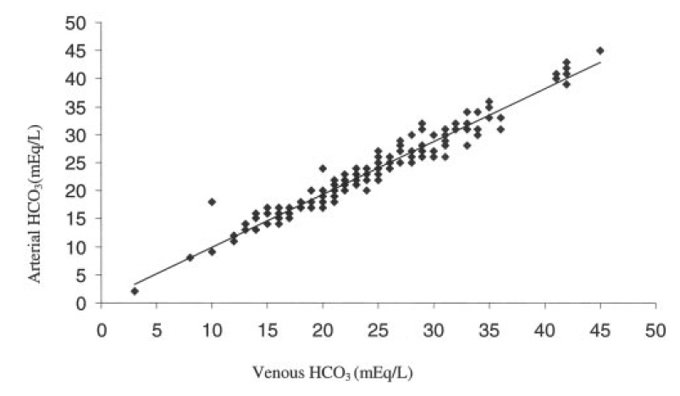
Figure 6
Venous vs arterial bicarbonate

Slide 23
★ Regression (회귀분석)
회귀분석이란 종속변수(Y)의 변화를 독립변수(X)들의 선형 조합으로
설명하려는 분석기법
Y=a+bx+c
독립변수가 1개 → 단일회귀분석 (simple regression)
독립변수가 여러개 → 다중회귀분석 (multiple regression)
X → venous value
Y → arterial value

Slide 24
Simple regression equation (단일회귀분석)
Arterial pH = - 0.307 + 1.05 x venous pH (R2 = 0.945)
Arterial PCO2 = 0.805 + 0.936 x Venous Pco (R2=0.883)
Arterial bicarbonate = 0.513 + 0.945 x venous bicarbonate (R2=0.950)
Notes:
R2 설명력

Slide 25
Multivariate regression equation (다중회귀분석)
to predict better the arterial values for pH, PCO2, and bicarbonate
Arterial pH = 0.545 + 0.0288 x venous pH - 0.00139 x venous PCO2 + 0.00269 x venous HCO3 (R2 = 0.948)
Arterial PCO2 = - 120.1 + 16.498 x venous pH + 1.193 x venous PCO2 -0.553 x venous HCO3 (R2 = 0.895)
Arterial HCO3 = - 23.666 + 3.268 x venous pH + 0.053 x venous PCO2 + 0.855 x venous HCO3 (R2 = 0.951)

Slide 26
“bivariate R2 values” vs “multivariate R2 values” ; R2
→ no advantage (in using the more complicated multivariate equations)
→ multivariate models do not account for significantly more variation than the corresponding simple linear regression equations
 | Bivariate(simple) | multivariate
pH | 0.945 | 0.948
CO2 | 0.883 | 0.895
Bicarbonate | 0.950 | 0.951
Notes:
R2 설명력

Slide 27
“central” vs “peripheral VBG” values
drawn from 14 patients
14 paired samples (one paired sample per patient)
 | Central (mean) | Peripheral (mean) | Central-Peripheral (mean)
pH | 7.34 | 7.34 | -0.001 (-0.01%)
PCO2 | 37.52 | 36.80 | 0.72 (1.94%)
bicarbonate | 21.18 | 20.87 | 0.31 (1.46%)

Slide 28
Discussion
VBG analysis clearly does not replace ABG analysis in determining exact Po2 status,
Arterial puncture may still be required for invasive arterial BP monitoring
But, given the well-accepted accuracy of pulse oximetry, VBG analysis may be a safer alternative to ABG analysis for determining acid-base status

Slide 29
previous studies
limited by specific patient group samples (e.g., patients with diabetic ketoacidosis),
analysis of only one or some parameters rather than all commonly used parameters (e.g., pH, Pco2, and bicarbonate),
examination of only one ABG and VBG sample per patient
A few authors even expressed ”doubts” about the use of VBG values in lieu of arterial values

Slide 30
Limitations
“40 patients” that met study inclusion criteria were enrolled.
prevalence of sepsis ↑
Other pathophysiologic states, such as pure hypovolemic shock and cardiogenic shock, were underrepresented
limit the generalizability of results, especially in patients with very low cardiac output

Slide 31
Limitations
study did include a wide range of acid-base status
arterial pH (6.73 to 7.63)
arterial bicarbonate (2 to 45 mEq/L)
arterial PCO2 (16 to 79 mmHg)
there were fewer values at the extremes.
These ranges encompass most of the values commonly encountered in an ICU setting

Slide 32
Conclusions
Peripheral or central venous pH, Pco2 and bicarbonate can replace their arterial equivalents in many clinical contexts that are encountered in the ICU.
Further work needs to be done to define better the relationship between ABG and VBG values in low-cardiac-output states.

