Slide 1
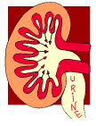
GLOMERULONEPHRITIS
Division of Nephrology,
Internal Medicine

Slide 2
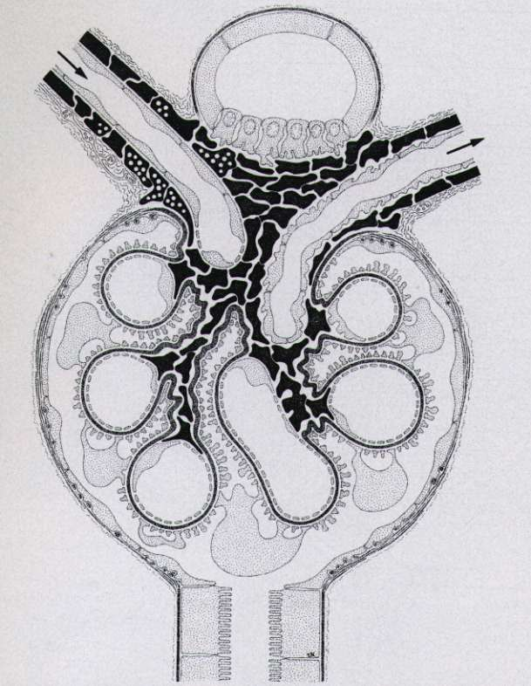
Symptoms and Signs
Injury to the glomeruli
by various immunologic or
non-immunologic mechanism
Proteinuria
Hematuria
Edema
Hypertension
Azotemia

Slide 3
사구체신염의 분류
임상 증상에 따른 분류 ( 5 Syndromes)
1) 무증상성 요이상(AUA) : IgA N
2) 신증후군(NS) : MCD, FSGS, MGN
3) 급성 사구체신염(AGN) : PSGN
4) 만성 사구체신염(CGN) : IgA N, MPGN
5) 급속진행성 사구체신염(RPGN) : crescentic GN

Slide 4
원인 질환에 따른 분류
1) 속발성 사구체신염
HS nephritis, lupus nephritis,
DM nephropathy
Hepatitis B virus associated GN, PSGN
2) 원발성 사구체신염
MCD, FSGS, MGN, MPGN, IgA N,
Crescentic GN
병리학적(형태학적) 분류

Slide 5
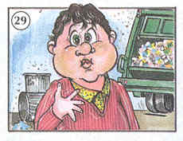
NEPHROTIC SYNDROME

Slide 6
Definition
NS
Children : Serum albumin < 2.5g/dl
Proteinuria > 40mg/m²/hr
Adult : Massive Proteinuria
( >3g/24h/1.73m²)
Hypoalbuminemia
Edema
Hyperlipidemia

Slide 7
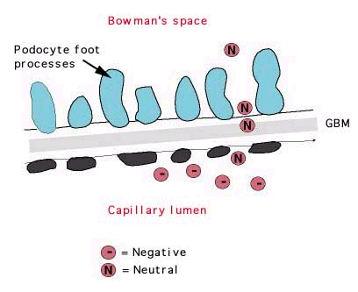
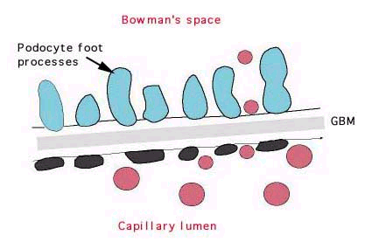
NS
Anti-proteinuric Barrier
Charge selective barrier : negatively charged sialoglycoprotein
Size selective barrier : 44A(effective molecular radius)

Slide 8
Classification
NS
Primary NS : MCD
FSGS
MGN
MPGN
Secondary NS :
Hepatitis B virus-associated GN
Lupus nephritis, Diabetic nephropathy

Slide 9
NS
Primary NS according to the age groups
Others
FSGS
MGN
MCD

Slide 10
NS
Etiologic Diagnosis of Secondary NS (N=220)
Diabetic nephropathy : m/c
Others
Renal amyloidosis
5.9%
HBGN
46.8%
Lupus Nephritis
39.5%

Slide 14
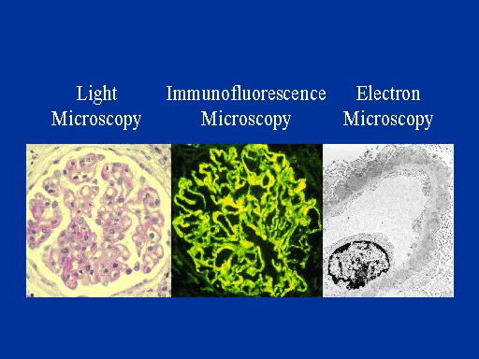

Slide 15
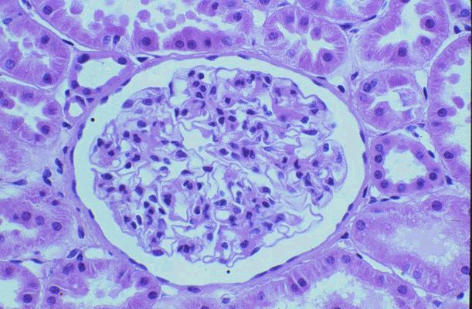
Normal Kidney (1)
H&E stained section

Slide 16
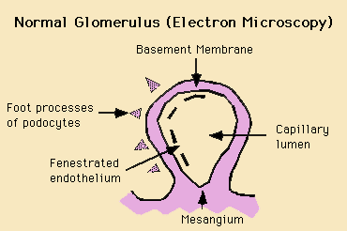
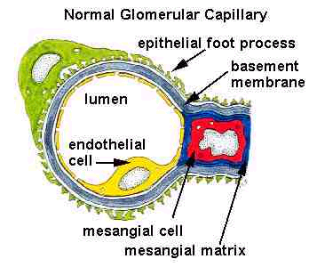
Normal Kidney (2)

Slide 17
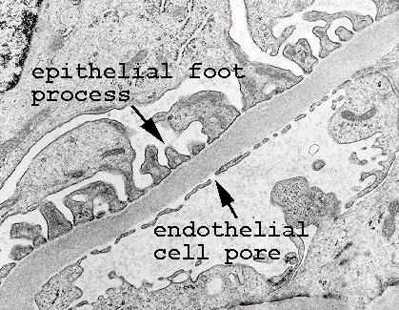
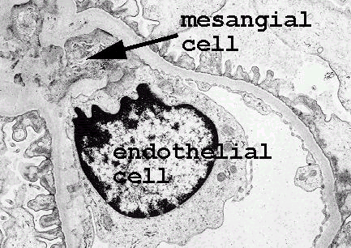

Slide 18
Minimal Change Disease (MCD)
Synonyms : Nil disease, Lipoid nephrosis
Foot process disease
Incidence : male>female
80% of NS in children
20-40 % of NS in adults
Cause : Drug (NSAIDs, rifampin, interferon a)
Hodgkin’s disease, HIV infection
Pathology : normal in LM, IF
epithelial foot process effacement in EM

Slide 19
Treatment
MCD
Highly steroid responsive, excellent prognosis to glucocorticoid therapy
90% (children) and 50% (adult) : remission after
8weeks of high dose steroid therapy
sometimes relapse upon tapering (50-70%)
Alkylating agents are reserved for frequent relapsers, cyclosporine for steroid resistant MCNS

Slide 20
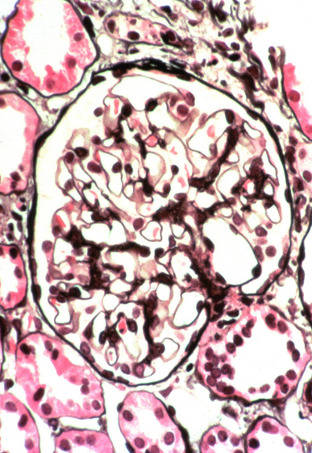
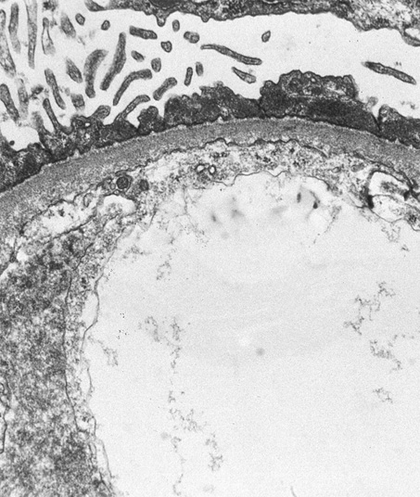
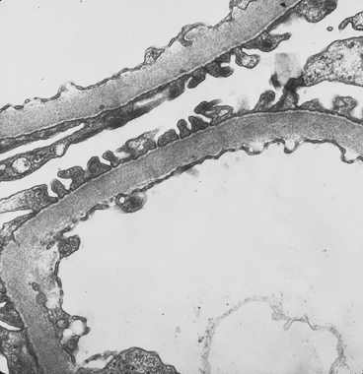
MCD
LM
EM

Slide 22
FSGS
특발성 신증후군의 10% 정도 차지,
원인 : 특발성, heroin abuse, VUR, AIDS,
solitary kidney
임상 양상 : 대부분 전형적인 신증후군(nonselective)
고혈압, 혈뇨, 신기능 저하
병리 : 비증식성, 경화성 변화
(초점성, 분절성)
면역 형광 소견은 비특이적
치료 : 장기간의 steoid 치료,
steroid 에 대한 효과가 낮음
예후 : 50% 환자가 7-10년에 ESRD 로 진행 ,
신이식 후에도 재발 흔함

Slide 23
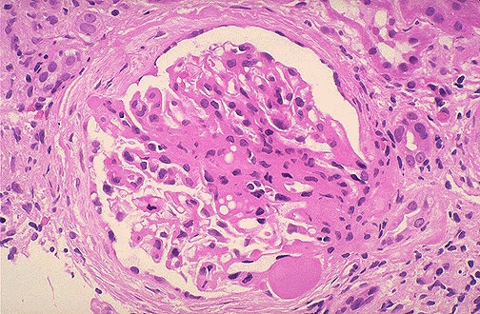
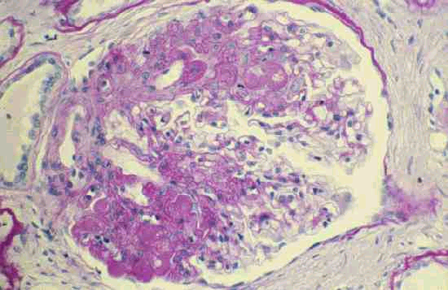
FSGS
LM

Slide 24
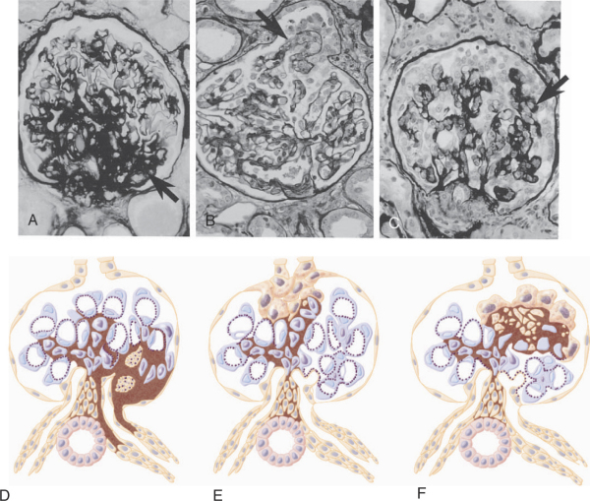
Notes:
Light micrographs and diagrams depicting patterns of focal segmental glomerulosclerosis. One pattern (A and D) has a predilection for sclerosis in the perihilar regions of the glomeruli. The glomerular tip lesion variant has segmental consolidation confined to the segment adjacent to the origin of the proximal tubule (B and E). The collapsing glomerulopathy variant has segmental collapse of capillaries with hypertrophy and hyperplasia of overlying epithelial cells (C and F) (Jones methenamine silver stain, ×100).

Slide 25
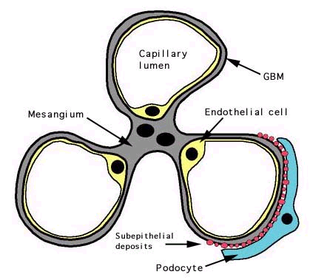
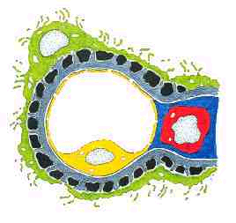
Membranous Nephropathy

Slide 26
MGN
1. Most common idiopathic NS in adults (40%)
Rare in children
Peak incidence between 30 and 50
2. Clinical manifestation
Mostly nephrotic (80%), Nonselective proteinuria
Microhematuria (50%)
HT : less than 30% at initial manifestation
but common later with renal progression

Slide 27
MGN
Pathology
LM : diffuse thickening of the GBM (PAS staining)
spike pattern (Silver staining)
IF : granular deposit of IgG, IgM, C3
EM : subepithelial electron dense deposit
stage I, II, III, IV

Slide 28
MGN
Etiology
Idiopathic (majority)
Systemic disease or drugs
1. Infection : hepatitis B, hepatitis C
2. Autoimmune disease : SLE, RA, MCTD
3. Malignancy : carcinoma
4. Drugs : gold, penicillamine, NSAID, captopril
5. Miscellaneous : sarcoidosis, DM,

Slide 29
MGN
Clinical Sx
① Mean onset age: 30 ∼ 50 age (male: female = 2:1)
② Older age: correlate with malignancy 20% (>60 age)
③ Massive proteinuria (80%), edema
④ RVT*: 50% - high incidence

Slide 30
MGN
Treatment & Prognosis
40% : spontaneous remission
30-40% : repeated relapse and remission
10-20% : persistent NS and progressive azotemia
(ESRD in 20 to 30 years)
Risk factors of renal progression :
male, older age at onset, heavy proteinuria,
hypertension, stage IV lesion, azotemia at initial Bx
Tx : no therapeutic effect with steroid alone
cyclophosphamide, chlorambucil, cyclosporine

Slide 31
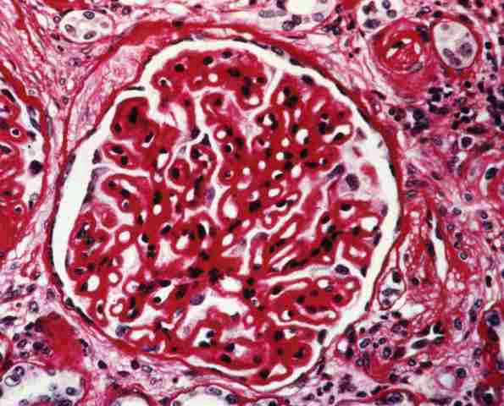
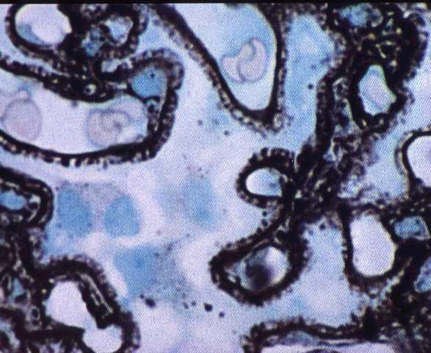
MGN
LM

Slide 32
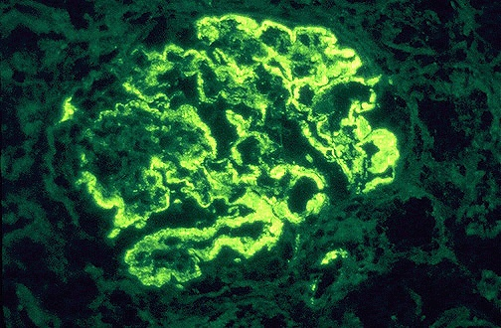
MGN
IF
EM
IF with antibody to IgG.
deposition of electron dense material and interposition of lighter GBM material-subepithelial deposition

Slide 33
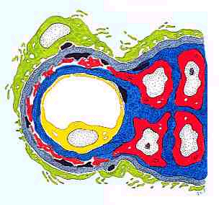
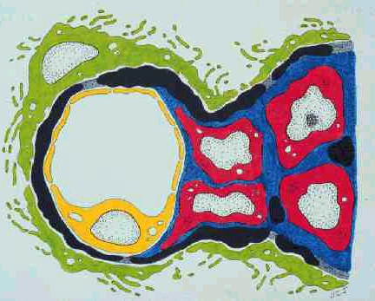
Membranous Proliferative Glomerulonephropathy
Type I: Subendothelial Deposits
Type II: Dense Deposit Disease

Slide 34
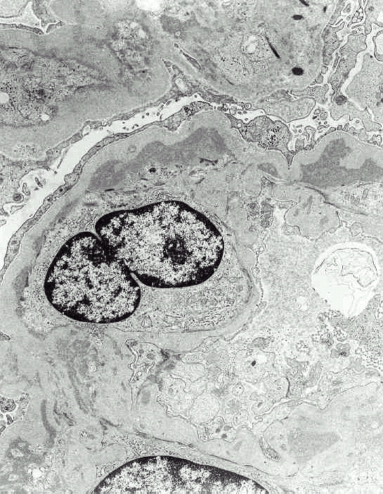
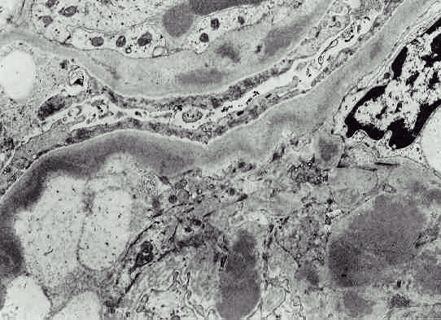
MPGN
EM
Type I: Subendothelial Deposits
Type II: Dense Deposit Disease

Slide 35
MPGN
Clinical Manifestation
Variable combination of nephritic or nephrotic features
Common in ages between 5-30
Decline in GFR, active urine sediment,
Proteinuria often in nephrotic range (50%)
Type I MPGN : Immune complex disease
C3 usually depressed
C1q, C4, properdin, factor B : borderline or low
Secondary MPGN : associated with infection, SLE, malignancy

Slide 36
MPGN
Pathology
Diffuse proliferation of mesangial cells
Increased mesangial matrix
Thickening and reduplication of GBM
(Double contour, Tram-tract)
Type I and type II MPGN
Prognosis
Poor, slow progression to ESRD
Worse in type II MPGN

Slide 37
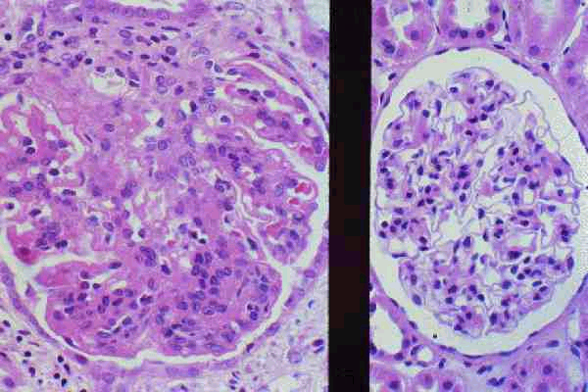
MPGN
LM
Normal kidney

Slide 38
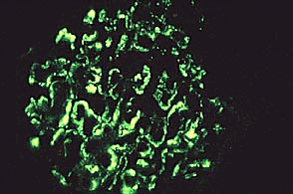
MPGN
EM
IF

Slide 39
Acute Glomerulonephritis or
Acute Nephritic Syndrome(AGN)

Slide 40
AGN
Acute glomerular inflammation
Sudden onset of acute renal failure and oliguria
Obstruction of glomerular capillary lumen
GFR falls Na and water retention
ECF volume expansion, Edema, Hypertension
U/A : RBC cast, dysmorphic RBC, leukocytes,
subnephrotic proteinuria
Often gross hematuria
Azotemia
General pathologic feature :
proliferative GN (capillary endothelial cell, mesangial cell)

Slide 41
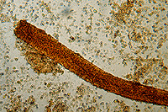

Slide 42
AGN - PSGN
PSGN
Acute post-streptococcal GN
Etiology : Pharyngeal or cutaneous infection with group A beta-hemolytic streptococcus, nephritogenic strain
Epidemiology : common in children, male > female
Latent period : 6-15 days (“post-pharyngitic”)
Hematuria (gross or microscopic),
Edema, mild HT,
Oliguria,
Nausea, mild fever,
Flank pain
ARF of variable degrees

Slide 43
Lab finding & Pathology
PSGN
U/A : hematuria, mild proteinuria
GFR reduced
Elevated ASO, anti-hyaluronidase, elevated anti-DNase B
Culture: Streptococcus in throat or skin
Complement level :
C3, CH50 markedly reduced, normalized in 8 weeks, C4 mildly reduced
LM : Diffuse endocapillary proliferation
PMN cell and monocyte infiltration
EM : hump (large subepithelial deposit: characteristic)
IF : IgG, C3 deposit

Slide 44
Treatment & prognosis
PSGN
Benign course in children
Acute symptom : relieved in 1-2 wks
U/A abnormality esp. hematuria persists for 2 years
Treatment : symptomatic
Rest, salt water restriction, diuretics, protein restriction
Antibiotics (PCN, EM) needed in limited cases
- i.e. incomplete treatment, elevated CRP

Slide 45
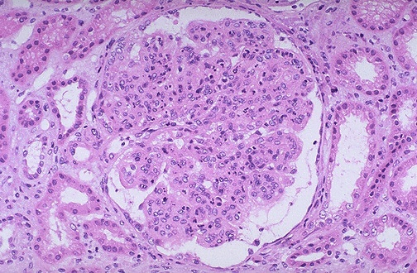
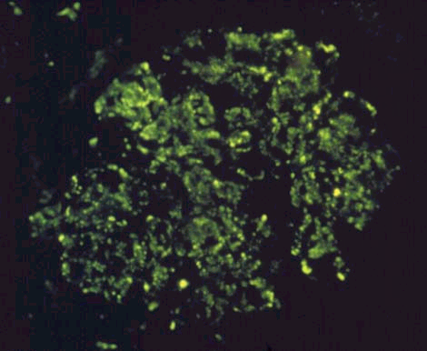
PSGN
LM
IF

Slide 46
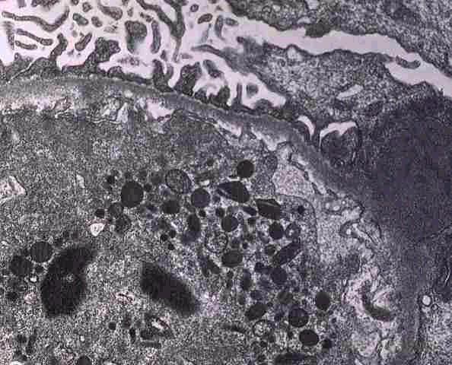
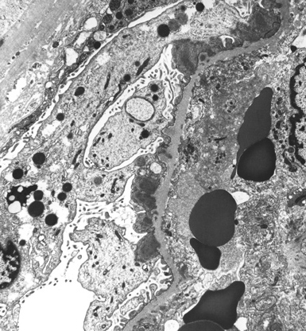
PSGN
EM

Slide 47
Asymptomatic Urinary Abnormality (AUA)
Hematuria or subnephrotic proteinuria without HT, renal insufficiency, edema
U/A abnormality : persistent or recurrent
Hematuria with or without proteinuria | Isolated non-nephrotic proteinuria
IgA Nephropathy Thin basement membrane disease Alport syndrome | Orthostatic proteinuria MN, FSGS, DM, amyloidosis

Slide 48
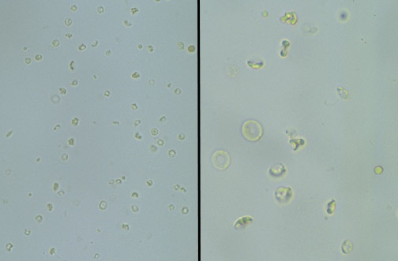

Slide 49
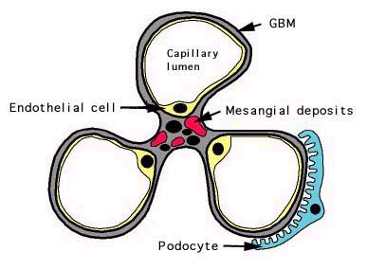
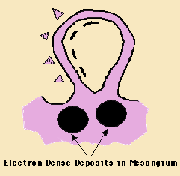
IgA Nephropathy

Slide 50
IgAN
Most common GN worldwide (10-40%)
Etiology : most cases are idiopathic
Clinical spectrum with Henoch-Schonlein Purpura
Secondary IgA N due to liver cirrhosis, Crohn’s disease
Epidemiology : between 16 and 35 years, male>female
Initial manifestation
Recurrent gross hematuria, often 24 to 48h after pharyngitis,
GI infection (“synpharyngitic”)
Or, microscopic hematuria during routine examination
HT, nephrotic proteinuria rare at initial presentation

Slide 51
IgAN
Lab : Elevated serum IgA level in 50% cases, circulating IgG or IgA Immune complex
Prognosis
20 to 50% progress to ESRD over 20 years
Poor prognosis group :
- Male sex
- Older age at onset
- Absence of gross hematuria
- heavy proteinuria
- Hypertension
- azotemia at initial diagnosis

Slide 52
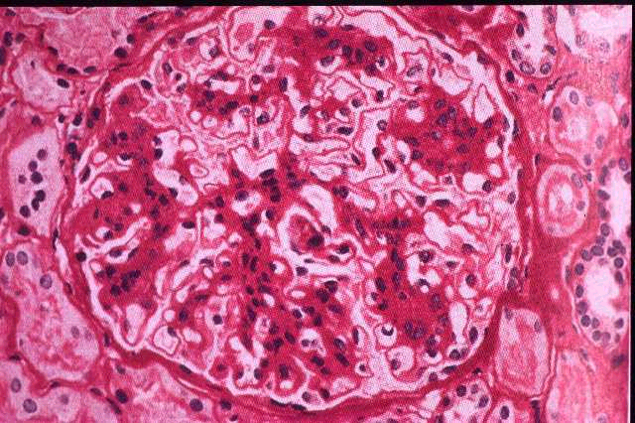
IgAN
LM
mesangial expansion with increased matrix and cellularity

Slide 53
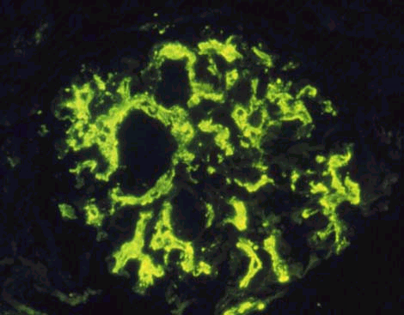
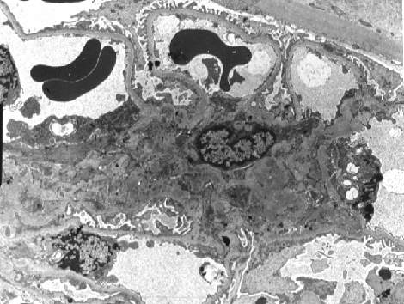
IgAN
Mesangial deposits of IgA
Subendothelial and subepithelial deposits are rarely seen.

Slide 54
AUA : Isolated Non-nephrotic Proteinuria of Glomerular Origin
Orthostatic Proteinuria
Persistent Proteinuria
Etiology : smoldering GN (mild mes. Prolif. GN, FSGS, focal or diffuse prolif. GN),
interstitial nephritis
Prognosis : slowly progressive azotemia
Dx : separate urine collection(7A-11P, 11P-7A)
Prognosis : excellent

Slide 55
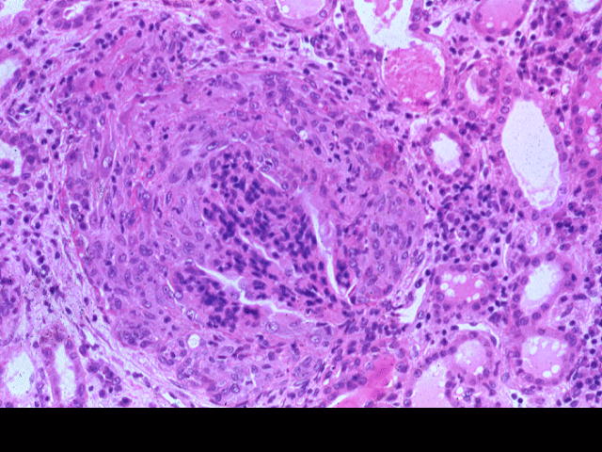
Rapidly Progressive
Glomerulonephritis (RPGN)
Crescent
Normal
glomerulus

Slide 56
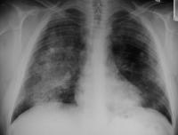
Patchy parenchymal consolidations are present, which usually are
bilateral, symmetric perihilar, and bibasilar.
The apices and costophrenic angles usually are spared

Slide 57
RPGN
RPGN
Subacute glomerular inflammation
Patient develop renal failure over weeks to months
Nephritic urinary sediment, subnephrotic proteinuria, oliguria, HT, hypervolemia, edema
Renal biopsy almost invariably shows crescents (=Crescentic GN)

Slide 58
Crescentic GN
RPGN
Pathology : diffuse crescent formation > 50% glomeruli
Clinically : progression to renal failure over weeks to months, clinical features of GN (proteinuria, hematuria, active urinary sediment)
If not properly treated, end stage renal disease ensues in 80-90%

Slide 59
Classification of Crescentic GN
RPGN
Type I : anti-GBM disease without pulmonary hemorrhage
Type II : Immune complex deposition
Type III : pauci-immune
(no immunoglobulin deposition)
ANCA (anti-neutrophil cytoplasm antibody) 양성

Slide 60
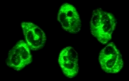
RPGN
C-ANCA on ethanol fixed slide
C-ANCA is identified as a positive result when there is intense positive granular staining of the cytoplasm that extends to the border of the human granulocyte substrate displaying a 1+ or greater fluorescence
and there is absence of nuclear staining
P-ANCA on ethanol fixed slide
P-ANCA exhibits intense positive perinuclear staining of the multi-lobed nucleus with a poorly defined cell border.
A 1+ or greater fluorescence is considered a positive result

Slide 61
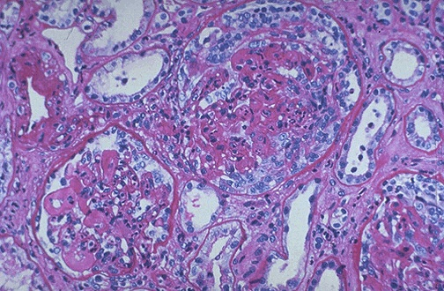
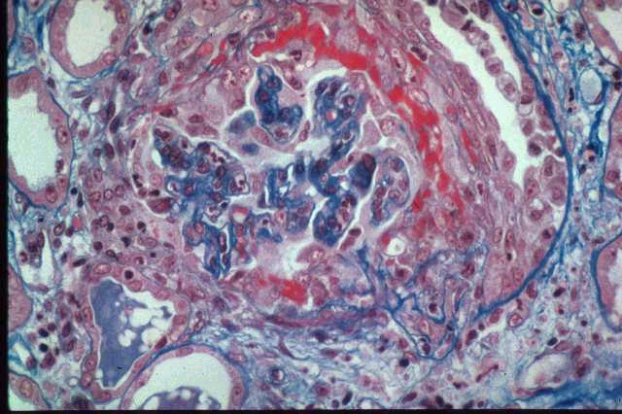
RPGN
LM

Slide 62
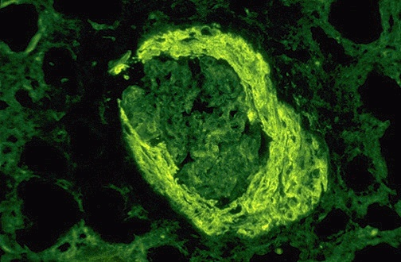
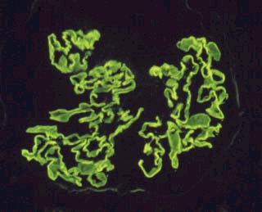
IF
RPGN
IF with antibody to fibrinogen.
There is a linear pattern of staining along the glomerular basement membrane with IgG.

Slide 63
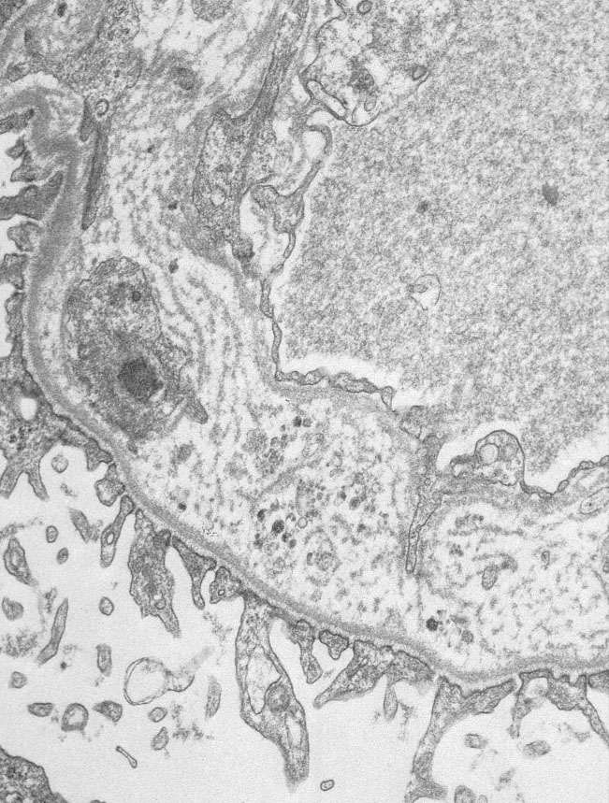
Alport’s Syndrome
Genetic defect in type IV collagen
Alpha 5 chain
X-linked dominant
Ant. lenticonus
Sensorineural hearing loss
Recurrent hematuria
Slowly progress to ESRD
EM : thickenend GBM with
lamellation, splitting

Slide 64
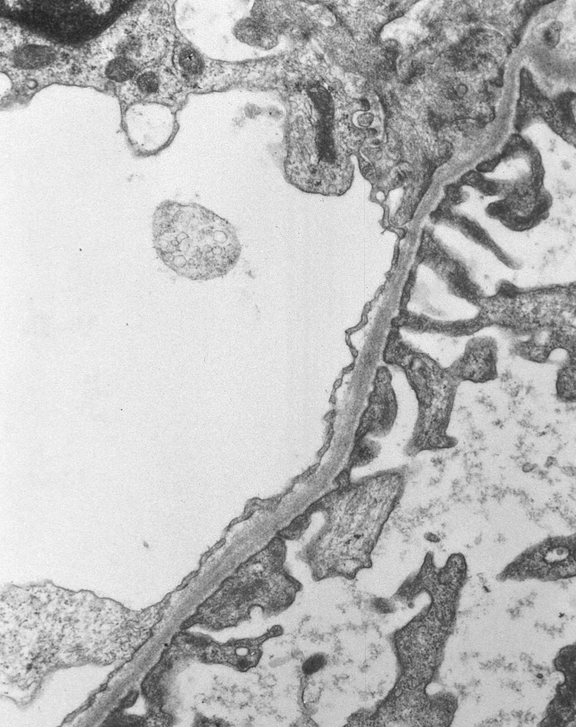
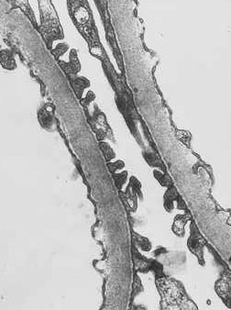
Thin Basement Membrane Disease (= Benign familial hematuria)

Slide 65
Chronic Glomerulonephritis (CGN)
Persistent proteinuria/hematuria/HT
Insiduous onset, slowly progressive renal insufficiency over years
Can be a manifestation of virtually all of the major GNs
Pathology : renal atrophy, cortical thinning, glomerulosclerosis irrespective of causative GN

Slide 66
Secondary GN
Lupus Nephritis
Systemic Vasculitis
Amyloidosis
Cast Nephropathy

Slide 67
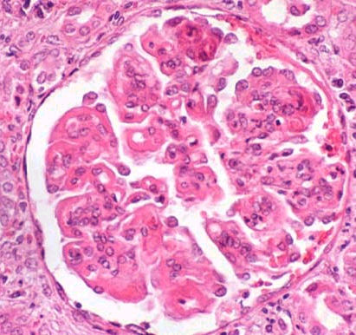
Lupus Nephritis
Lupus Nephritis -- Diffuse Proliferative

Slide 68
Amyloidosis
Nodular pattern apple green on polarized light

Slide 69
Randomly oriented thin fibrils
(EM: x 51,250)

Slide 70
Cast Nephropathy
T-H protein(cast)

Slide 71
Diagnostic Approach to GN

Slide 72
Etiologies of AUA
Hematuria with or without proteinuria | Isolated non-nephrotic proteinuria
IgA Nephropathy Thin basement membrane disease Alport syndrome | Orthostatic proteinuria MN, FSGS, DM, amyloidosis

Slide 73
1. Clinical feature가 사구체신염인가?
Proteinuria, Hematuria, Edema, Hypertension, Azotemia(PHEHA)
Hematuria of glomerular origin :
dark color, no clot formation, RBC cast, dysmorphic RBC,
overt albuminuria/proteinuria(>1g)
Pathologic proteinuria of glomerular origin :
not orthostatic but persistent proteinuria, mainly albuminuria on urine PEP,
accompanied by glomerular hematuria

Slide 74
2. 사구체신염의 임상증후군 가운데 어디에 해당되는가?
NS
AGN
RPGN
CGN
AUA
Physical Exam : BP, edema
U/A : RBC cast, WBC cast,
oval fat body
24H urine collection
for protein quantitation
Blood Chemistry: protein/albumin
cholesterol, BUN/Cr
Serial Check of BUN/Cr
Kidney sono : renal size,
echogenecity

Slide 75
3. 사구체신염을 일으키는 원인질환이 있는가?
Age/Sex
History : URI, family Hx
Physical exam : skin rash, purpura, skin infection, arthritis, oral ulcer
X-ray : pulm.hemorrhage, arthritis
Hepatitis B, C, HIV, VDRL, FTA-ABS
ASO, anti-DNase B, CRP, cryoglobulin, RA factor, FANA, anti-dsDNA, C3/C4 level, ANCA, anti-GBM antibody

Slide 76
Serum complement가 감소하는 질환
Idiopathic GN | Secondary GN
Acute PSGN, MPGN type I, II | Lupus nephritis, GN secondary to SBE, Cryoglobulinemia

Slide 77
4. 사구체신염 진단을 위해 신생검이 필요한가?
 | GN의 원인적 진단이 이루어진 경우 | GN의 원인이 명확하지 않는 경우
진단명 | 조직형태와 무관하게 원인에 따라 진단명을 붙인다. 예> Lupus nephritis, hepatitis B associated GN | 조직 형태에 따라 진단. 예> idiopathic MN, MPGN, IgA N
신생검을 하는 목적 | 질환의 신침범 정도와 그에 따른 예후 파악 | 형태학적 진단 및 진단에 따른 예후 파악

Slide 78
Renal Biopsy
Renal biopsy provides tissues that can be used to determine the diagnosis, indicate the cause, predict the prognosis, direct treatment and collect data for research.

Slide 79
Renal Biopsy
Indication
1. The cause cannot be determined or predicted by less invasive techniques
2. Signs and symptoms suggest parenchymal disease that requires pathologic evaluation
3. DDx includes diseases that have different treatments or different prognosis

Slide 80
Usually Needed in
Renal Biopsy
Nephrotic syndrome in adults
Steroid resistant NS in children
GN in adults other than clear-cut PSGN or lupus nephritis
ARF of unknown cause
RPGN
Activity or chronicity determination of lupus nephritis

Slide 81
Method
Renal Biopsy
Localization of kidney by real-time ultrasound
Biopsy needles : Vim-Silverman,
Gun biopsy needle
(spring loaded disposable gun needle)
1-1.5cm length cortical tissue needed
Visualized under LM, FM and EM

Slide 82
Renal Biopsy

Slide 83
Renal Biopsy

Slide 84
Renal Biopsy

Slide 85
Renal Biopsy

Slide 86
Complications
Renal Biopsy
Small perirenal hematoma : common
Gross hematuria (< 10%)
AV fistula (< 1%)
Massive bleeding that requires surgery (< 1%)
Mortality (< 0.1%)

Slide 87
Contraindication
Renal Biopsy
Uncooperative patient
Solitary Kidney
Uncontrolled severe hypertension
Bleeding tendency
Severe anemia or dehydration
Cystic kidney
Hydronephrosis
Multiple renal a. aneurysms
APN, perinephric abscess, renal neoplasm
Sclerotic kidney, ESRD

